Slide 1

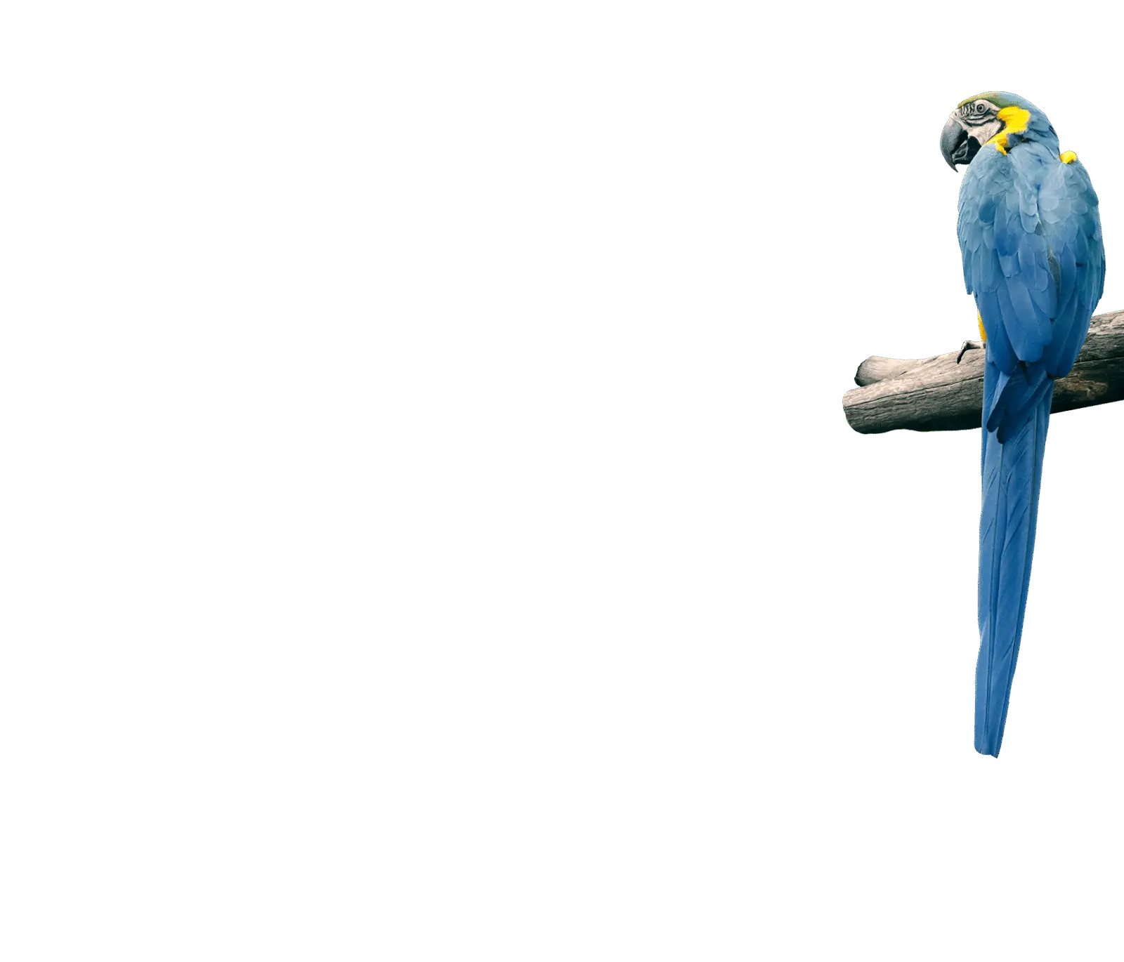
Optimal Birdwatching in Massachusetts:
Bird Frequency Forecasts &
Time-Location Recommendations
Phase 1 - Final Presentation
Team 2: Michael Aldoroty, Neil Ghosh, Nhat Pham, Hajera Siddiqui
DS 5500
Notes:
Give updates on our

Slide 2
Agenda
Summary
Methods
Results
Discussion

Slide 3
Introduction
Birdwatching connects enthusiasts with conservation efforts
Challenges:
Planning Difficulty
Advancements in technology identification, not sighting
eBird can be challenging to navigate and lacks predictive features
Objectives:
Forecast weekly detection rates of bird species in Massachusetts
Offer hotspot and timing suggestions
Develop an interactive, user-friendly dashboard
Notes:
Michael
Introduction & Problem Statement
2. Challenges:
Challenges for Beginner Birdwatchers: Struggle to plan effective outings due to limited knowledge of prime locations and timings for bird sightings.
Despite advancements in bird identification tech, there is still a need for better bird sighting recommendations.
Platforms like eBird offer rich historical data but can be challenging to navigate and lack predictive capabilities.
Slide Notes:
Birdwatching fosters conservation awareness.
Planning Difficulty: Simplify birdwatching trip planning.
Tech Advancements: Bridge gap between bird identification and sighting recommendations.
eBird Challenges: Address navigation issues, add predictive features.
Objectives: Forecast bird detection, offer hotspot and timing suggestions, create user-friendly dashboard.

Slide 4
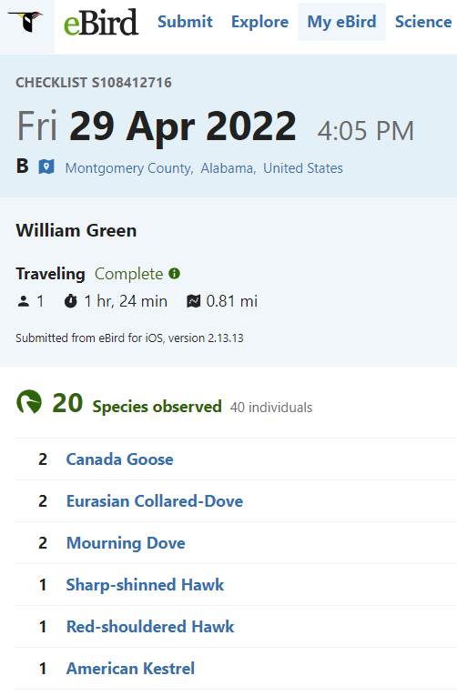
eBird Data
From Cornell Lab of Ornithology
1B+ bird sighting records submitted by global bird enthusiasts
Checklist features: location, date, start time, effort, observer count
Observation features: species, bird count
Notes:
Hajera
eBird is the most popular application among birdwatchers to log bird sightings
It was developed by the Cornell Lab of Ornithology
The dataset is organized into two primary components: checklist data and observation data.
checklist data:
The main features: Each checklist summarizes the observations made during bird-watching outings, including aggregated details such as the total count of each species and contextual information like the location, date, start time, and the number of participants.
Observation data:
Each row represents an individual bird species sighting, providing detailed information about the species observed like the species type and the bird count.
They have been providing this rich dataset of bird sightings to the public since 2002, updated monthly

Slide 5
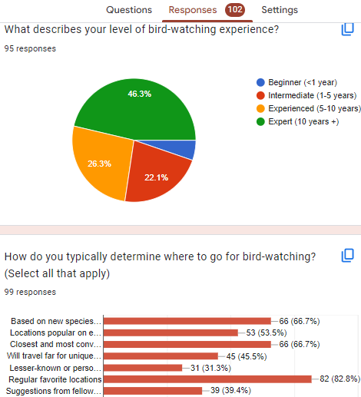
Final Dataset
Local birder survey: 102 responses, with 83% favoring familiar, nearby locations, 84% log every bird they see
Decision to focus the analysis on Massachusetts
17M records of bird observations from 2013-2022
Limited to 50 most commonly observed species due to time constraint
Notes:
Hajera
We sent out a survey to local birding groups and asked questions about their birding behaviors like how they pick where to go and how they use eBird to log birds.
Got 102 responses learned that:
Notably:
83% favor familiar, nearby locations, aka people bird locally => supports our decision to focus the analysis on Massachusetts only
84% log every bird they see => shows that despite its shortcomings as a human-logged, citizen science dataset, ebird is reliable.
Final dataset: 17M records of bird observations from 2013-2022, focused on 50 most commonly observed species due to time constraint

Slide 6
Methods

Slide 7

Data Processing
Used ‘auk’ R package for data cleaning
Removed duplicate group entries
Filtered data to ensure quality: complete checklist, time & distance thresholds, etc.
Data transformation:
Aggregated bird sightings to weekly intervals by county
Detection rate = Number of checklists with the specific species/ Total checklists for that week and county
Imputed null detection rates in weeks without checklists
Notes:
Neil

Slide 8
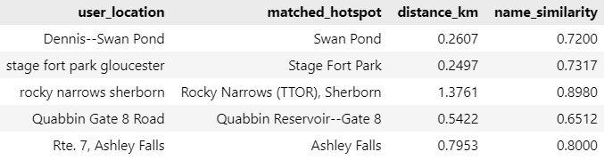
Data Processing - Geolocation
Data includes 3500+ hotspots and 110,000+ user-input locations
Combined KDTree for spatial and Levenshtein ratio for textual accuracy in matching locations
Criteria: spatial proximity ≤ 0.8km and name similarity score ≥ 0.65
Successfully aligned 10% of user entries with established hotspots
Notes:
Neil

Slide 9
Forecast Models
Assessed ARIMA/SARIMAX, Gaussian Processes, Prophet, and Greykite.
Prophet and Greykite outperformed in accuracy and scalability → Implemented 700 models for 50 species using each model.
Splitted data into training set (2013-2021) and testing set (2022)
Employed smoothing techniques for more stable data patterns
Evaluation metrics: RMSE and MAE for performance, model runtime for scalability
Notes:
Hajera
- We looked at multiple models to create our forecasts, which include ARIMA/SARIMAX, Gaussian Processes, Prophet, Greykit
- Out of all of the models explored, Prophet and Greykite outperformed in accuracy & scalability in our initial testing
- we the implemented 700 models for 50 different bird species.
- for all of our models we split the data into a training set, so data from 2013 to 2021, and a testing set, data from 2022
- to get more stable patterns, applied various smoothing techniques
- we used rmse and MAE for performance metrics while we used runtime for scalability

Slide 10
Prophet
Employed additional data processing to make data into appropriate form for model
Utilized yearly seasonality, periods of 104 weeks, and week frequency parameters
Used a train test split of historical data up to 2021 and forecasting data beyond
Evaluated using RMSE and MAE
Used rolling average and exponential smoothing to decrease noise and variation
Determined exponential smoothing produces better results
Trained model on 50 birds and 14 different counties in 4 minutes and 28 seconds
Notes:
Hajera
Employed additional data processing to coerce our data into an appropriate form for our model, this included removing unneeded rows and columns, changing the datatypes of the values and names of the columns
Gave the initial model a weekly dataset to determine a forecast for each county.
Utilized yearly seasonality, periods of 104 weeks, and week frequency parameters
Used a train test split of historical data up to 2021 and forecasting data beyond
Evaluated using RMSE and MAE values
From our baseline model, we noticed the plots we were getting were sporadic and sparse for some counties. So to decrease noise and variation from the citizen data collection period, we started exploring rolling average and exponential smoothing.
We discovered that exponential smoothing produced more stable plots along with better RMSE and MAE values
We then increased the number of birds to 50 birds species for all 14 Massachusetts counties and trained the model. The runtime for this iteration was about 4 and a half minutes.

Slide 11
Greykite
Silverkite: a two-phase time series forecasting algorithm in Greykite that models conditional means and fit volatility to residuals
01
Baseline and Model Tuning
Created a baseline model with default Silverkite
Fine-tuned baseline model for diverse growth patterns through changepoints, optimized via grid search
02
Seasonality & Autoregression
Integrated seasonality and autoregression to reflect natural cycles and temporal correlations
03
Cross Validation
Assessed model using the train-test split
Also implemented 2-fold rolling window cross-validation
04
Model Evaluation
Compared baseline and tuned model using RMSE & MAE to determine the optimal model for each bird-county
Notes:
Neil

Slide 12
Time-Location Descriptive Analysis
Conducted two descriptive analyses on 2019-2022 data to recommend optimal birdwatching times and hotspots
Determined best birdwatching times by analyzing species sightings in two-hour daily intervals
Determined best hotspots out of a pool of 3,592 in MA using spatial and textual similarity to the actual specie sighting
Finally, developed an interactive Tableau dashboard that combines the machine learning output with descriptive insights for additional nuance to the weekly detection rate predictions provided
Notes:
Neil

Slide 13
Results

Slide 14
Greykite vs Prophet
Data smoothing improved performance for both, with exponential smoothing being most effective
Greykite offered higher predictive accuracy in 575/ 696 models
Prophet outperformed in speed, taking 5.36 seconds per bird versus Greykite's 2 minutes per bird
Prioritized Greykite for accurate forecasts over speed, fitting our goal to offer birdwatchers precise predictions, with speed de-emphasized for static dashboard integration
Future optimizations: enhance Greykite's speed or improve Prophet's accuracy
Notes:
We ran 700 models for 50 species in 14 counties using both Prophet and Greykite. With both algorithms, smoothing methods significantly improved model performance compared to using raw data. We chose exponential smoothing as it yields the highest accuracy and also relevant for our context, as we believe that more recent observations are more indicative of future patterns.
Overall, Greykite outperformed Prophet in terms of accuracy, with the majority of models having lower RMSE and MAE
However, Prophet models were much faster, with processing time of 5.36 seconds per bird, compared to Greykite's 2 minutes per bird.
For this phase of the project, we prioritized prediction accuracy over speed and chose Greykite as our final model. This aligns with our goal to provide precise information to bird watchers. Also, speed is less critical as we are using stored prediction results for the dashboard, not real-time data.
We do plan to either improve Greykite's runtime or enhance Prophet's accuracy in phase 2

Slide 15
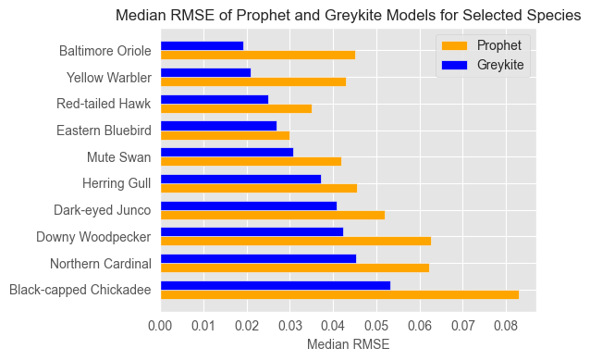
Notes:
For each species, there are 14 models for 14 counties. This graph compares the median RMSE of 14 models for selected species using Prophet vs Greykite.
We have seasonal birds like Oriole, Yellow Warbler, Dark-eyed Junco, and resident birds like Black-capped chickadee, Northern Cardinal, and some year round migrants whose appearance in MA is less consistent like Eastern bluebird, Herring Gull
Overall, Greykite models have lower RMSE

Slide 16
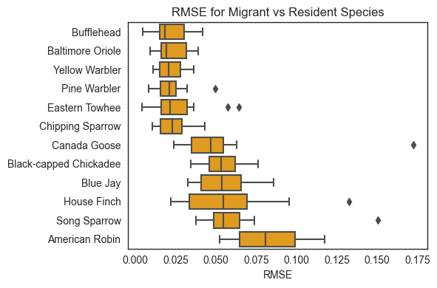
Greykite Results
Overall, fine-tuned Greykite models achieve satisfactory predictive performance, median RMSE = 0.034 and median MAE = 0.026
Species variation:
Migratory birds showed high accuracy due to clear seasonal patterns
Resident birds had higher RMSE/MAE and wider confidence intervals, likely influenced by variable detection rates and complex behaviors
Notes:
Here are some more results of the final fine-tuned Greykite model. Overall, models’ performances were satisfactory, with a median RMSE of 0.034 and median MAE of 0.026
We saw variation in model performance across species.
Models for migratory birds such as bufflehead, oriole, warbler etc. have higher accuracy, or lower RMSE as you can see here. This is attributed to the strong seasonality in their detection rates
Models for resident birds such as Canada goose, blue jay etc. have higher RMSE and wider confidence interval, as you can see here. There are a few factors we think influence this, such as their widespread occurrence leading to more variable detection patterns, potential underreporting by birdwatchers

Slide 17
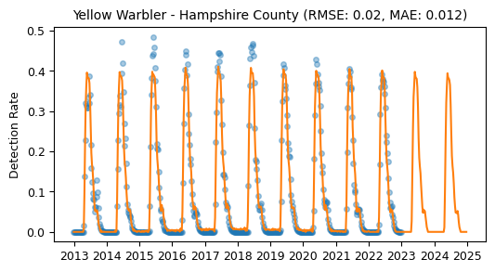
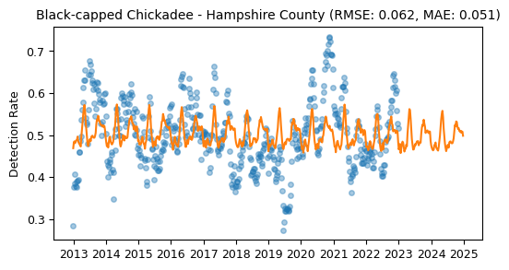
Actual vs forecast detection rates of
Migrant…
… vs resident species
Notes:
These graphs show the actual (blue dots) vs forecast (orange lines) detection rates of a migrant species vs a resident species. As you can see, the strong seasonality makes yellow warbler much easier to predict than BCC

Slide 18
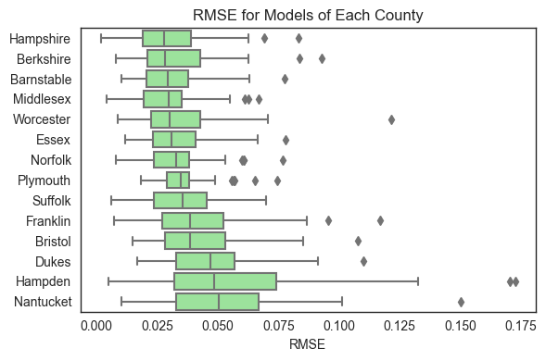
Greykite Results
County variation:
Models for Hampshire, Berkshire, Barnstable, and Middlesex counties showed better performance
Nantucket, Dukes, and Hampden counties had higher variability in detection rates due to unique ecological characteristics and data limitations.
Notes:
We saw variation in model performance across counties.
Models for Western Massachusetts counties like Hampshire and Berkshire have better performance, probably because of their natural landscapes, lower population density hence consistently stable bird populations . Barnstable is Cape Code has diverse habitats hence consistently stable bird populations. Middlesex is a big county, has high urban density, but lots of conservation areas and for the past few years, always have the highest volume of checklists submitted, hence good data quality.
On the other hand, N and D are islands and have limited data and unique bird populations, hence their models perform worse.
Hampden is a small county with mixed urban-rural setting, introduced a greater degree of variability in bird detection rates.

Slide 19
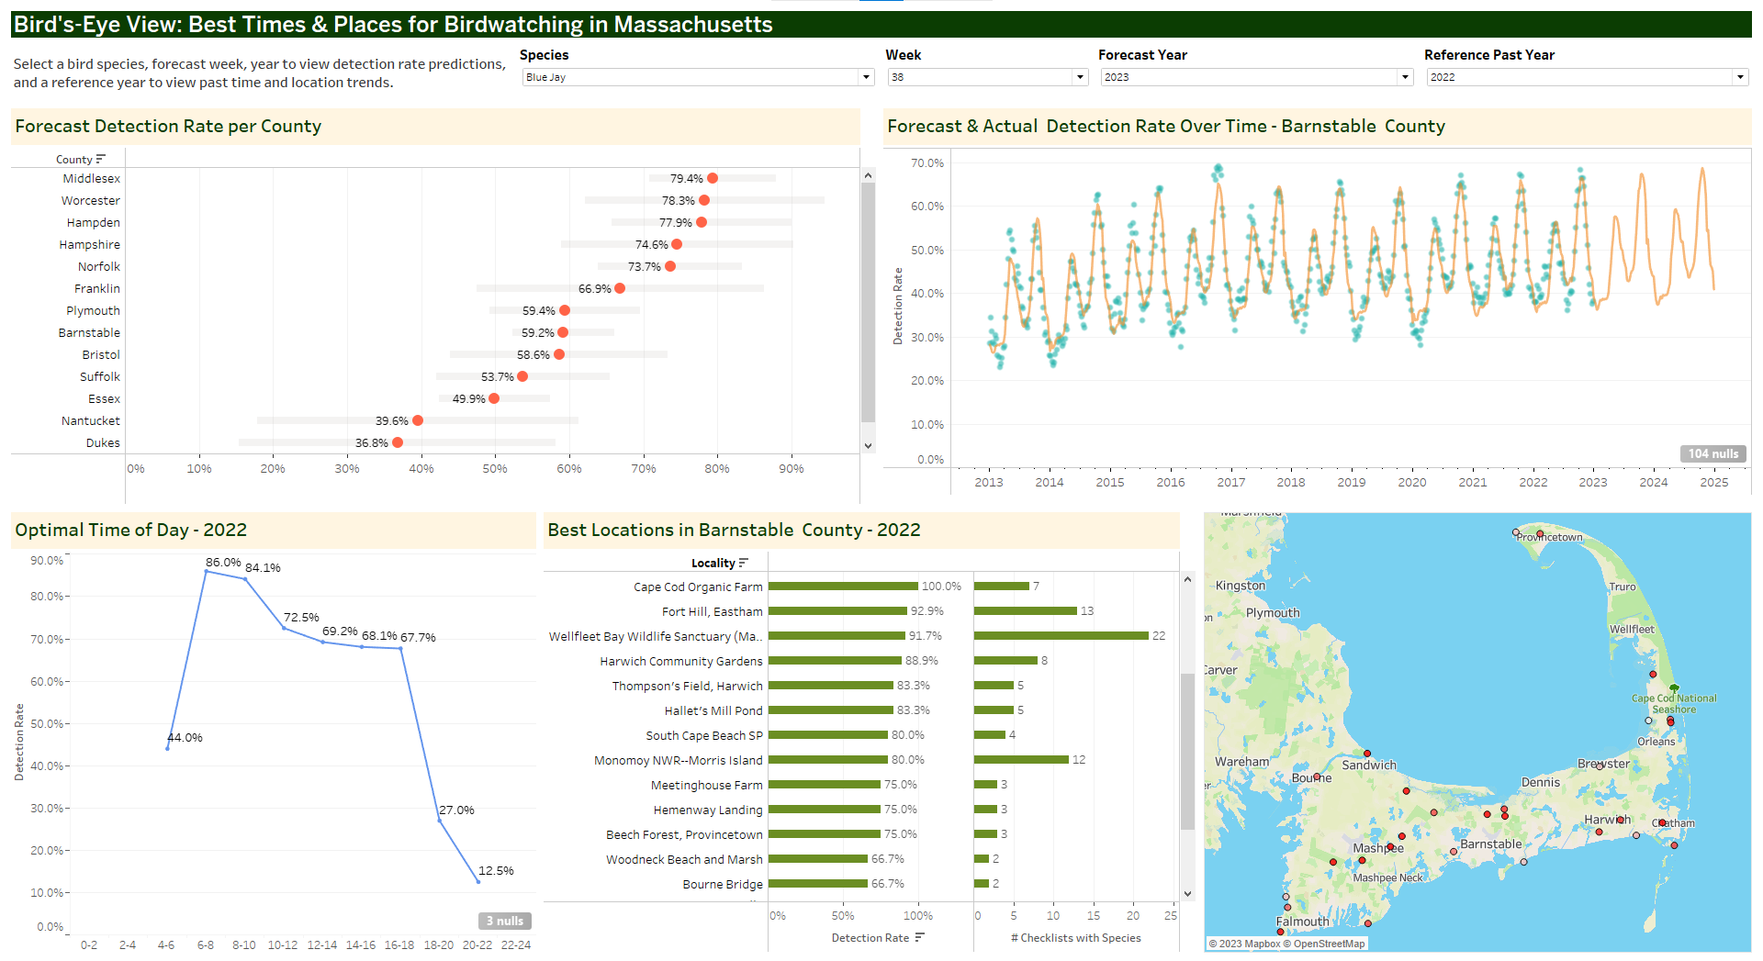
Dashboard Demo
https://bit.ly/3SqWssj
Notes:
We developed a Tableau dashboard to display both predictive and descriptive analyses’ results. It is publicly accessible through this link, but to ensure the quality when sharing, i will show it from the desktop version.
To start, we ask user to choose a species they want to see. Let’s say I want to see a Dark-eyed Junco - a seasonal bird that is in MA only in the winter. Say I want to see it next week, I will choose week 47 of 2023.
Top left chart shows the forecast detection rate of this bird in each county, and top right chart shows the actual vs forecast detection rates over the past 10 years
Now I want to know what time in the day and which specific location should I go to to have a higher chance of seeing this bird. For this time-location suggestions, we use past data. User will choose one of the recent years and we will show them the trend for this species during this week in that past year.
Base on data from last year, if I go out at 6-8am, i will have the highest chance of detecting the bird
Location suggestions are county-specific. Let say I want to check out some spots in Hampshire county as I see that it has the highest detection rate - so i will click there to get specific location suggestions for this county.
This chart shows the detection rate of this bird in this week in several locations, ranked from high to low detection rate.
Since detection rate itself could be a bit misleading, so we also show users the # of checklist with that species. For example, all checklists submitted at Hampshire college has this species, but that was only 3 checklists. Arcadia Wildlife Sanctuary has a bit lower detection rate but that was based on more observations/ there were more people seeing the bird there so maybe I will go there instead.
Now say Western Mass is too far, I want to stay local so I will look for suggestions in Middlesex.
The chart has some interactive features, as in if you click into a location, the map will highlight that location only, and if you click into the dot in the map, it will lead you to a google maps page of that location for navigation
One thing that a lot of birders noted in the survey is that they wanted to look for new under birded areas. We think that this feature will help users explore new areas they have not been to, and is a step toward maybe a more deepdive analysis on identifying overbirded vs underbirded areas.
For the time of day, we see that most species have peak activity in early morning (4-8am), but there are some variations across species, such as coast birds like ring-billed gull are also active in the afternoon, probably due to tidal cycles, or Hawks are actually more active in late morning. As we expand the project and include more species, we expect this feature to be useful for birdwatching planning and for understanding of different species’ behaviors.
Next Michael with discuss our conclusions we have for this phase.

Slide 20
Discussion
Impacts
Enhanced birdwatching: Accurate forecast models and an interactive dashboard
Bird Behavior insights aid short and long-term conservation
Limitations
Sparse data in Dukes and Nantucket give less accurate results
Greykite is more accurate but complex, less scalable
Notes:
Michael
Impacts:
Enhanced birdwatching: Accurate forecast models and user-friendly dashboard simplify planning and make birdwatching more rewarding.
Insights into bird behavior patterns support conservation planning, providing valuable information for both short-term and long-term initiatives.
Limitations:
Sparse data in Dukes and Nantucket counties presented difficulties in achieving accurate forecasts, highlighting the importance of data availability for effective predictions.
In the choice between Greykite and Prophet for forecasting, Greykite demonstrated higher accuracy but introduced complexity and required longer training periods. This may impact the scalability of our solution when dealing with larger datasets.

Slide 21
Future Work
Model Development
Continue model tuning
Add regressors (ex. weather)
Pipeline automation
Transition to a production-ready system for automated updates
Spatial data integration
Enhance models with habitat and migratory data
User engagement
Develop a recommendation system for prime birdwatching locations
Notes:
Michael
Automation Pipeline:
Improve forecast model (Prophet & Greykite tuning).
Add regressors like weather and pollution data.
Spatial Data Integration:
Incorporate habitat quality, land use, and migratory patterns for more precise predictions.
User Engagement:
Leverage survey data for a recommendation system.
Address overbirded and underbirded areas for balanced birdwatching opportunities.

Slide 22
Thank you!
Comments / Questions?

Slide 23
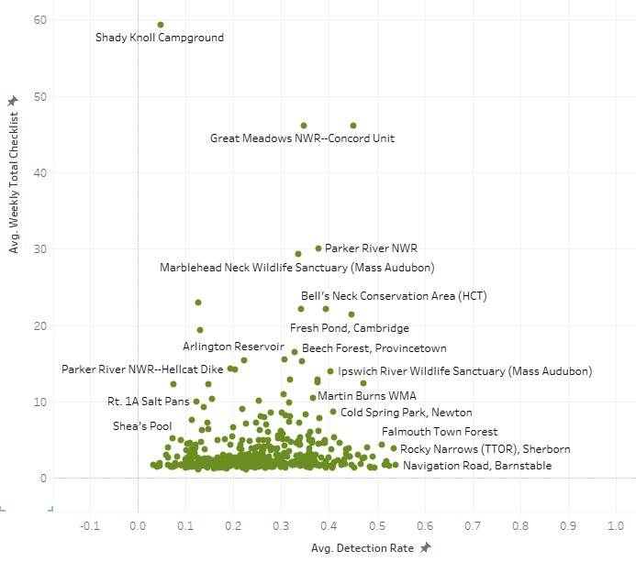
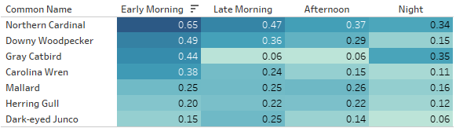
Time-Location Analysis
Preliminary findings indicate potential overbirded vs. underbirded areas
Most birds show peak morning activity, yet species-specific diurnal patterns emerge
Detection rate for selected species by times of day
Notes:
Lastly, we performed some additional analysis using the time and hotspot dataset used to create time-location suggestions in the dashboard
We analyzed time and hotspot data to improve time-location suggestions on our dashboard.
Early morning hours (4-8am) show high activity for most bird species. Coastal species like Bufflehead and Gulls are also active in afternoons, likely due to tides affecting food availability. This table shows diurnal variation in bird activity, indicating different patterns for various species.
More species will be added to the project, which is expected to reveal greater variability and enhance understanding of bird behavior.
We investigated new hotspots based on local birders' interests, identifying overbirded and underbirded areas. Overbirded spots have many checklists but low detection rates; underbirded spots have the opposite.
This scatter plot shows the relationship between checklist counts and detection rates, highlighting places like Shady Knoll Campground as overbirded. Further research is planned to explore these preliminary findings more deeply.

Slide 24
Discussion
Gained numerous valuable insights into bird populations and their detection across various MA counties and had significant implications for improving birdwatching.
Although most counties contained plentiful data, the sparsity and volatility of the Dukes and Nantucket counties made generating accurate forecasts challenging. The potential causes may include a limited number of citizens reporting bird sightings, potential mismatches between the birds in the dataset and the specific habitats on these islands.
Greykite exhibited greater flexibility in terms of tuning and garnered better values of RMSE and MAE than Prophet. But with increased tunability, there are hist to the level of complexity and scalability. Greykite model ran considerably slower, not optimal for larger datasets.
There are multitude of bird species and due to monthly updates to Cornell's Lab of Ornithology data, there may be concerns about training times becoming impractical.
Consequently, further comparisons with Prophet, involving additional tuning, are warranted to assess how it scales in comparison to Greykite.
Users can use Tableau dashboard to see where hotspots are and know when a bird will be at its most detectable in the future.

Slide 25
Phase 1 Milestones: Completed ✓
Oct 4: User interviews & surveys ✔
Oct 8: Data collection ✔
Oct 12: Data processing ✔
Oct 18: Explore different models on one species ✔
Oct 22: Tune models for a few species ✔
Oct 31: Generalized models for all species and preliminary Tableau dashboard ✔

Slide 26
Greykite
Silverkite: a two-phase time series forecasting algorithm in Greykite that models conditional means and fit volatility to residuals
Created a baseline model with Silverkite’s defaults, then fine-tuned for diverse growth patterns through changepoints, optimized via grid search
Integrated seasonality and autoregression to reflect natural cycles and temporal correlations
Assessed model using the train-test split and 2-fold rolling window cross-validation
Compared baseline and tuned models using RMSE, MAE to determine the optimal model for each bird-county.
Notes:
Neil

